Slide 1
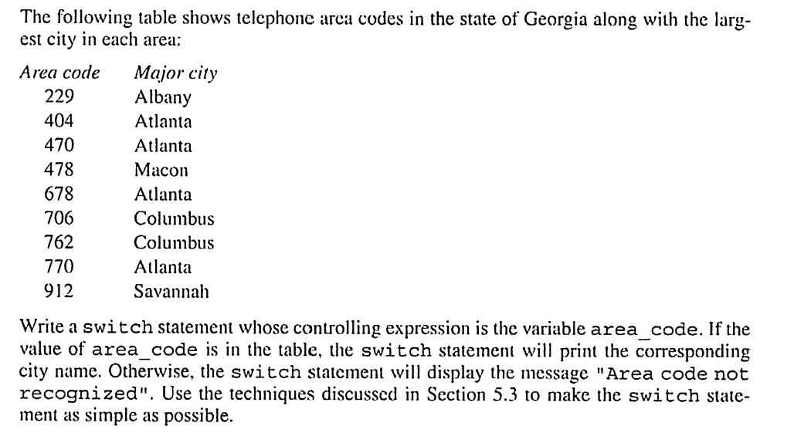
1. What is the numerical value of each of the following expressions?
a. 5 > 2
b. 3 + 4 > 2 && 3 < 2
c. x >= y || y > x
d. d = 5 + ( 6 > 2 )
e. 'X' > 'T' ? 10 : 5
f. x > y ? y > x : x > y
2.

Slide 2
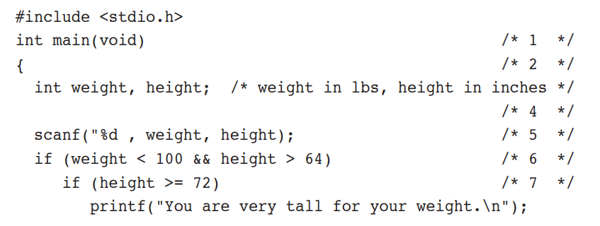
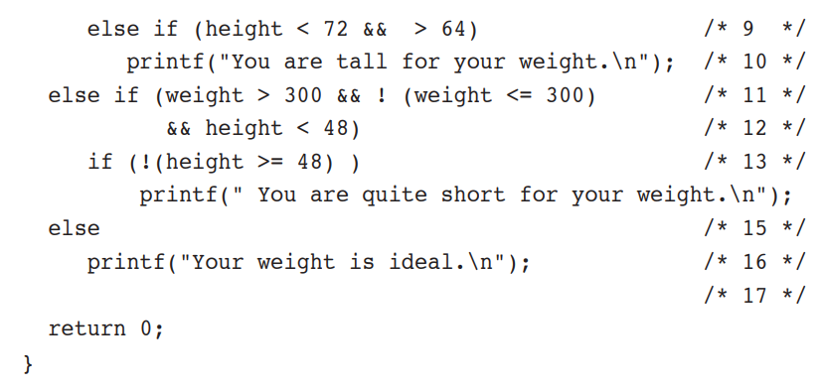
3. The following program has unnecessarily complex relational expressions as well as some outright errors. Simplify and correct it.

Slide 3
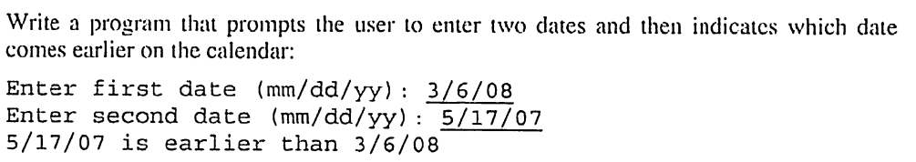
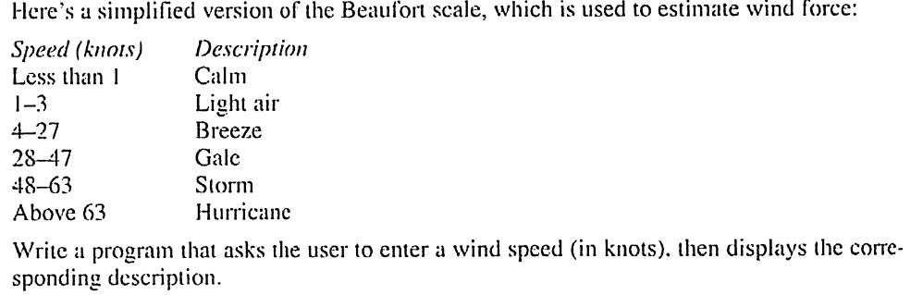
4.
5.

